Slide 1
22CS304 – Operating Systems
OBJECTIVES:
The Course will enable learners to:
Explain the basic concepts of operating systems and process
Discuss threads and analyse various CPU scheduling algorithms
Describe the concept of process synchronization and deadlocks
Analyse various memory management schemes
Describe I/O management and file systems

Slide 2
22CS304 – Operating Systems
UNIT I INTRODUCTION TO OPERATING SYSTEMS AND PROCESSES
Introduction to OS –Computer system organization - architecture – Resource management - Protection and Security – Virtualization - Operating System Structures - Services - User and Operating-System Interface - System Calls - System Services - Design and Implementation - Building and Booting an Operating System - Process Concept - Process Scheduling - Operations on Processes – Inter process Communication - IPC in Shared-Memory Systems - IPC in Message-Passing Systems
UNIT II THREADS AND CPU SCHEDULING
Threads & Concurrency: Overview - Multicore Programming - Multithreading Models - Thread Libraries - Implicit Threading - Threading Issues - CPU Scheduling: Basic Concepts - Scheduling Criteria - Scheduling Algorithms - Thread Scheduling - Multi- Processor Scheduling - Real-Time CPU Scheduling
UNIT III PROCESS SYNCHRONISATION AND DEADLOCKS
Process Synchronization - The critical-section problem, Peterson’s Solution - Synchronization hardware, Mutex locks, Semaphores, monitors, Liveness - Classic problems of synchronization – Bounded Buffer Problem - Reader’s & Writer Problem, Dinning Philosopher Problem, Barber’s shop problem. Deadlock - System model - Deadlock characterization, Methods for handling deadlocks - Deadlock prevention - Deadlock avoidance - Deadlock detection - Recovery from deadlock
UNIT IV MEMORY MANAGEMENT
Memory Management: Contiguous Memory Allocation - Paging - Structure of the Page Table – Swapping - Virtual Memory: Demand Paging – Copy-on write – Page Replacement – Allocation of frames – Thrashing Memory – Compression
UNIT V FILE MANAGEMENT
File Management: File Concept – Access Methods – Directory Structure – Protection - Memory-Mapped File - Disk Management: Disk structure, Disk scheduling - FCFS, SSTF, SCAN, C-SCAN, Disk reliability, Disk formatting, Boot-block, Bad blocks - I/O Hardware: I/O devices, Device controllers, Direct Memory Access - Case Study-Linux.

Slide 3
22CS304 – Operating Systems
OUTCOMES:
Upon completion of the course, the students will be able to:
CO1: Implement the basic concepts of operating systems and process.
CO2: Analyse various CPU scheduling algorithms and thread mechanism.
CO3: Implement the concepts of process synchronization and deadlocks.
CO4: Design various memory management schemes to given situation.
CO5: Implement various I/O and file management techniques

Slide 4
Unit I - INTRODUCTION TO OPERATING SYSTEMS AND PROCESSES
Introduction to Operating System
Operating System:
A program that acts as an intermediary between a user of a computer and the computer hardware
Operating system goals:
Execute user programs and make solving user problems easier
Make the computer system convenient to use
Use the computer hardware in an efficient manner

Slide 5
Unit I - INTRODUCTION TO OPERATING SYSTEMS AND PROCESSES
Introduction to Operating System
Computer System Structure
Computer system can be divided into four components:
Hardware
Provides basic computing resources
CPU, memory, I/O devices
Operating system
Controls and coordinates use of hardware among various applications and users
Application programs
Define the ways in which the system resources are used to solve the computing problems of the users
Word processors, compilers, web browsers, database systems, video games
Users
People, machines, other computers

Slide 6
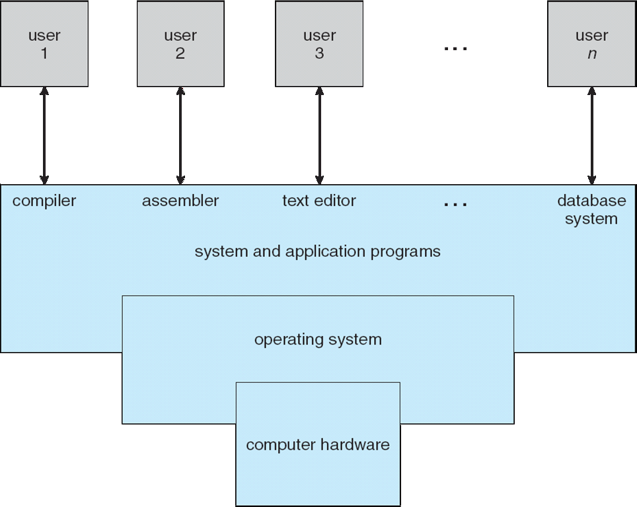
Unit I - INTRODUCTION TO OPERATING SYSTEMS AND PROCESSES
Introduction to Operating System
Four Components of a Computer System

Slide 7
Unit I - INTRODUCTION TO OPERATING SYSTEMS AND PROCESSES
Introduction to Operating System
Operating System Definition
OS is a resource allocator
Manages all resources
Decides between conflicting requests for efficient and fair resource use
OS is a control program
Controls execution of programs to prevent errors and improper use of the computer
OS is “The one program running at all times on the computer” is the kernel.
Everything else is either
a system program (ships with the operating system) , or
an application program
bootstrap program is loaded at power-up or reboot
Typically stored in ROM or EPROM, generally known as firmware
Initializes all aspects of system
Loads operating system kernel and starts execution

Slide 8
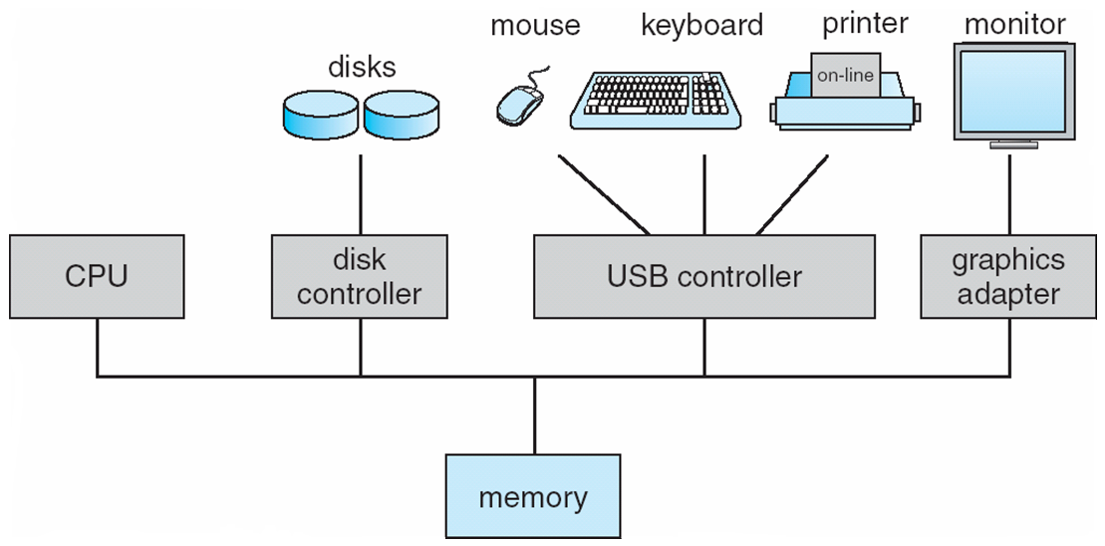
Unit I - INTRODUCTION TO OPERATING SYSTEMS AND PROCESSES
Computer System Organization
Computer-system operation
One or more CPUs, device controllers connect through common bus providing access to shared memory
Concurrent execution of CPUs and devices competing for memory cycles
I/O devices and the CPU can execute concurrently
Each device controller is in charge of a particular device type
Each device controller has a local buffer
CPU moves data from/to main memory to/from local buffers
I/O is from the device to local buffer of controller
Device controller informs CPU that it has finished its operation by causing an interrupt

Slide 9
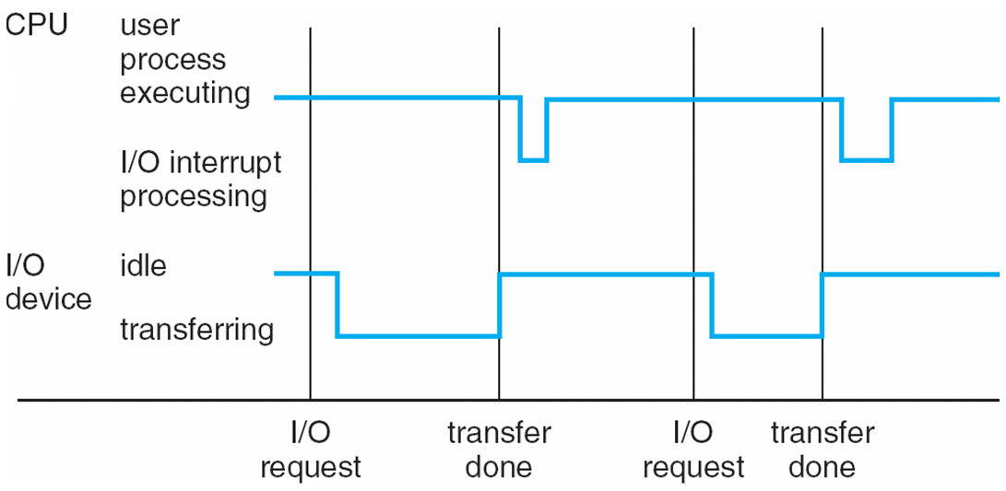
Unit I - INTRODUCTION TO OPERATING SYSTEMS AND PROCESSES
Computer System Organization
Interrupt transfers control to the interrupt service routine generally, through the interrupt vector, which contains the addresses of all the service routines
Interrupt architecture must save the address of the interrupted instruction
A trap or exception is a software-generated interrupt caused either by an error or a user request
An operating system is interrupt driven
The operating system preserves the state of the CPU by storing registers and the program counter
Determines which type of interrupt has occurred:
polling
vectored interrupt system
Separate segments of code determine what action should be taken for each type of interrupt

Slide 10
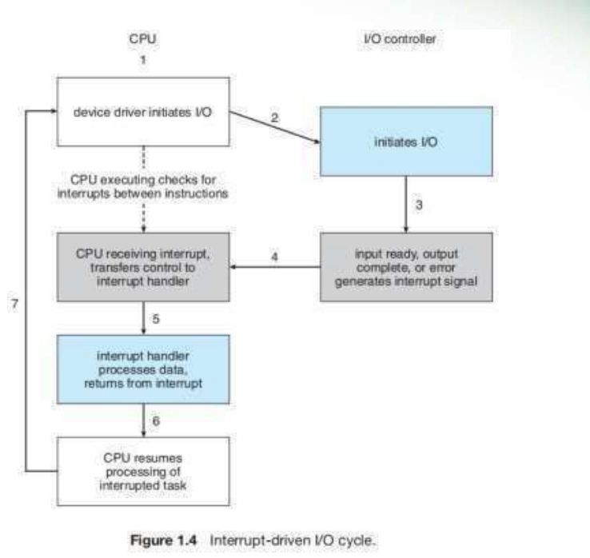

Slide 11
Unit I - INTRODUCTION TO OPERATING SYSTEMS AND PROCESSES
Computer System Organization
Storage Structure
Main memory – only large storage media that the CPU can access directly
Random access
Typically volatile
Secondary storage – extension of main memory that provides large nonvolatile storage capacity
Hard disks – rigid metal or glass platters covered with magnetic recording material
Disk surface is logically divided into tracks, which are subdivided into sectors
The disk controller determines the logical interaction between the device and the computer
Solid-state disks – faster than hard disks, nonvolatile
Various technologies
Becoming more popular

Slide 12
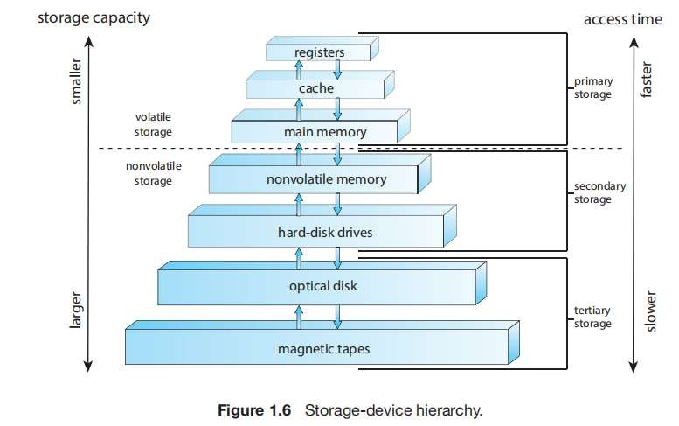
Unit I - INTRODUCTION TO OPERATING SYSTEMS AND PROCESSES
Computer System Organization - Storage-Device Hierarchy
Storage systems organized in hierarchy
Speed
Cost
Volatility
Caching – copying information into faster storage system; main memory can be viewed as a cache for secondary storage
Device Driver for each device controller to manage I/O
Provides uniform interface between controller and kernel

Slide 13
Unit I - INTRODUCTION TO OPERATING SYSTEMS AND PROCESSES
Computer System Organization
Storage Structure – Cache Memory
Important principle, performed at many levels in a computer (in hardware, operating system, software)
Information in use copied from slower to faster storage temporarily
Faster storage (cache) checked first to determine if information is there
If it is, information used directly from the cache (fast)
If not, data copied to cache and used there
Cache smaller than storage being cached
Cache management important design problem
Cache size and replacement policy

Slide 14
Unit I - INTRODUCTION TO OPERATING SYSTEMS AND PROCESSES
Computer System Organization
I/O Structure
Interrupt-driven I/O is used for moving small amounts of data.
High overhead when transferring large amounts of data
To solve this Direct Memory Access (DMA) is used.
DMA
Used for high-speed I/O devices able to transmit information at close to memory speeds
Device controller transfers blocks of data from buffer storage directly to main memory without CPU intervention
Only one interrupt is generated per block, rather than the one interrupt per byte

Slide 15
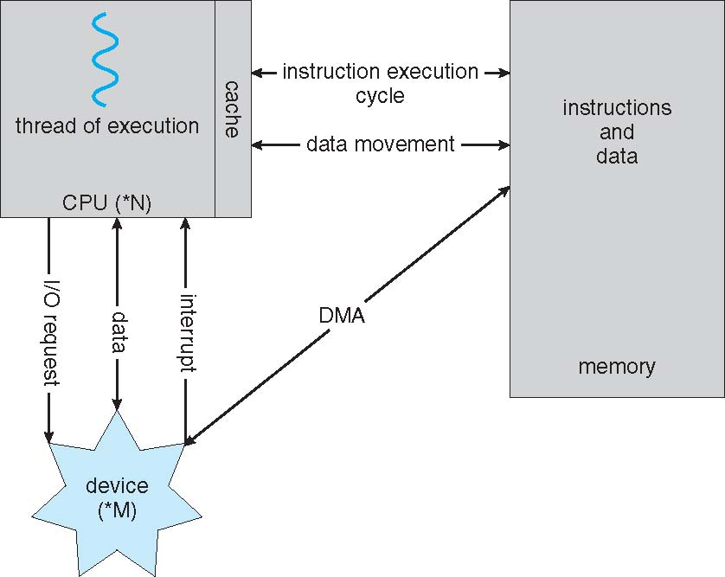
Unit I - INTRODUCTION TO OPERATING SYSTEMS AND PROCESSES
Computer System Organization
To start the I/O operation
the device driver loads the appropriate registers within the device controller.
Device Driver Examines the registers and determine the action to be taken.
The controller start transferring the data from the device to its local buffer.
Once the data transfer is done, the device controller informs the driver via an interrupt.

Slide 16
Unit I - INTRODUCTION TO OPERATING SYSTEMS AND PROCESSES
Computer System Architecture
DEFINITIONS OF COMPUTER SYSTEM COMPONENTS
CPU—The hardware that executes instructions
• Processor—A physical chip that contains one or more CPUs.
• Core—The basic computation unit of the CPU.
• Multicore— Including multiple computing cores on the same CPU.
• Multiprocessor— Including multiple processors.

Slide 17
Unit I - INTRODUCTION TO OPERATING SYSTEMS AND PROCESSES
Computer System Architecture
 | MultiCore | MultiProcessor
1. | A single CPU or processor with two or more independent processing units called cores that are capable of reading and executing program instructions. | A system with two or more CPU’s that allows simultaneous processing of programs.
2. | It executes single program faster. | It executes multiple programs Faster.
3. | Not as reliable as multiprocessor. | More reliable since failure in one CPU will not affect other.
4. | It has less traffic. | It has more traffic.
5. | It does not need to be configured. | It needs little complex configuration.
6. | It’s very cheaper (single CPU that does not require multiple CPU support system). | It is Expensive (Multiple separate CPU’s that require system that supports multiple processors) as compared to MultiCore.

Slide 18
Unit I - INTRODUCTION TO OPERATING SYSTEMS AND PROCESSES
Computer System Architecture
Single Processor Systems
Computer System containing one CPU with a single processing core.
Core – Component that executes instructions and registers for sharing data locally.
One CPU with core
Can able to execute general purpose instruction set, including instructions from processes
Most systems have special-purpose processors as well
Device specific processors – disk, keyboard
Works autonomously
Ex : Disk-controller microprocessor receives sequence of requests from CPU core.
Implement its own disk queue and scheduling algorithms

Slide 19
Unit I - INTRODUCTION TO OPERATING SYSTEMS AND PROCESSES
Computer System Architecture
Multiprocessor Systems
Multiprocessors systems growing in use and importance
Computer System containing two or more processors with a single processing core.
Share the computer bus, memory and peripherals
Also known as parallel systems, tightly-coupled systems
Advantages include:
Increased throughput – increase in processors, more work done in less time
Speed up ratio – It is not N with N processors, Less than N
Overhead is there when multiple processors are executing
Two types:
Asymmetric Multiprocessing – each processor is assigned a specie task.
Symmetric Multiprocessing – each processor performs all tasks

Slide 20
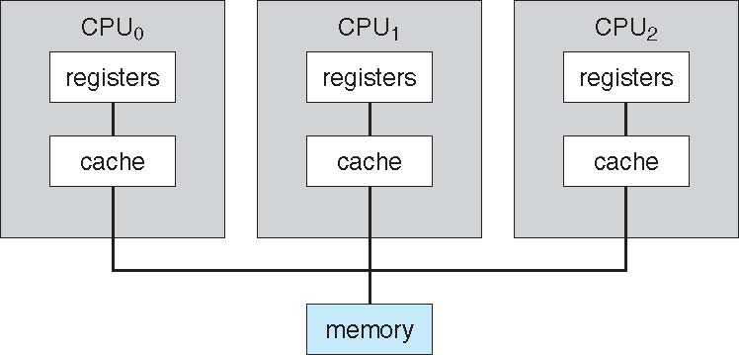
Unit I - INTRODUCTION TO OPERATING SYSTEMS AND PROCESSES
Computer System Architecture
Symmetric Multiprocessor
CPU Processor performs all tasks
More than one processor
Having its own CPU, set of registers, Cache
Processors share physical memory over the system bus
N Processes can run if there are N CPUs
Disadvantage:
CPUs are separate, one may be sitting idle while another is overloaded.

Slide 21
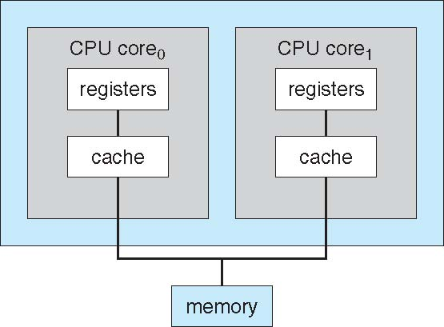
Unit I - INTRODUCTION TO OPERATING SYSTEMS AND PROCESSES
Computer System Architecture
Dual Core Design
Multiple computing cores reside on a single chip
Multicore systems are more efficient than multiple chips with single cores
On-chip communication is faster than between-chip communication.
One-chip with multiple cores uses significantly less power than multiple single-core chips.

Slide 22
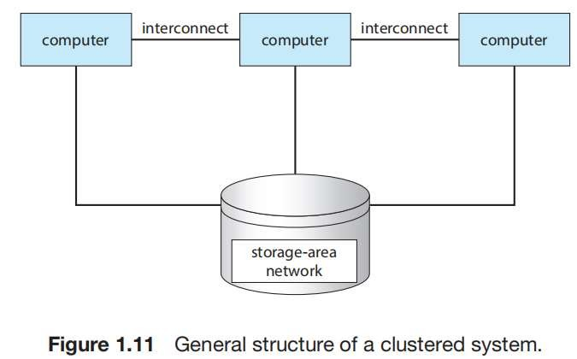
Unit I - INTRODUCTION TO OPERATING SYSTEMS AND PROCESSES
Computer System Architecture
Clustered Systems
Another multiprocessor system is a clustered system which gathers together multiple CPUs.
Usually sharing storage via a storage-area network (SAN)
Provides a high-availability service which survives failures
Asymmetric clustering has one machine in hot-standby mode
Hot-standby does nothing
If server fails, hot-standby host becomes server.
Symmetric clustering has multiple nodes running applications, monitoring each other
Some clusters are for high-performance computing (HPC)
Applications must be written to use parallelization
Dividing a program into separate components that run in parallel
Once completed the solved solutions are combined.
Some have distributed lock manager (DLM) to avoid conflicting operations
To provide shared access to data, access control and locking is provided by the system.

Slide 23
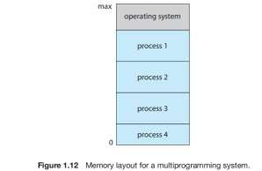
Unit I - INTRODUCTION TO OPERATING SYSTEMS AND PROCESSES
Operating System Structures
Multiprogrammed system
A program in execution is termed a process.
The operating system keeps several processes in memory simultaneously
The operating system picks and begins to execute one of these processes.
Eventually, the process may have to wait for some task, such as an I/O operation, to complete.
Non-Multiprogrammed system
The CPU would sit idle.
The operating system simply switches to, and executes, another process.
When that process needs to wait, the CPU switches to another process, and so on.
As long as at least one process needs to execute, the CPU is never idle.
Multitasking is a logical extension of multiprogramming.
In multitasking systems, the CPU executes multiple processes by switching among them, but the switches occur frequently, providing the user with a fast response time.

Slide 24
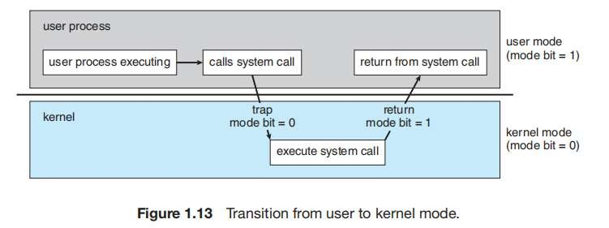
Unit I - INTRODUCTION TO OPERATING SYSTEMS AND PROCESSES
Operating System Structures
Dual-Mode and Multimode Operation
Distinguish between the execution of operating-system code and user defined code.
Two separate modes of operation: user mode and kernel mode (also called supervisor mode, system mode, or privileged mode).
A bit, called the mode bit, is added to the hardware of the computer to indicate the current mode: kernel (0) or user (1).
When the computer system is executing on behalf of a user application, the system is in user mode.
However, when a user application requests a service from the operating system (via a system call), the system must transition from user to kernel mode to fulfill the request.

Slide 25
Unit I - INTRODUCTION TO OPERATING SYSTEMS AND PROCESSES
Operating System Structures
Dual-Mode and Multimode Operation
The dual mode of operation provides us with the means for protecting the operating system from errant users.
The hardware allows privileged instructions to be executed only in kernel mode.
If an attempt is made to execute a privileged instruction in user mode, the hardware does not execute the instruction but rather treats it as illegal and traps it to the operating system.
CPUs that support virtualization frequently have a separate mode to indicate when the virtual machine manager (VMM)—and the virtualization management software—is in control of the system.
In this mode, the VMM has more privileges than user processes but fewer than the kernel
The lack of a hardware-supported dual mode can cause serious shortcomings in an operating system.
Once hardware protection is in place, it detects errors that violate modes. These errors are normally handled by the operating system.

Slide 26
Unit I - INTRODUCTION TO OPERATING SYSTEMS AND PROCESSES
Operating System Structures
Timer:
ensure that the operating system maintains control over the CPU.
cannot allow a user program to get stuck in an infinite loop or to fail to call system services and never return control to the operating system. To accomplish this goal, we can use a timer.
A timer can be set to interrupt the computer after a specified period. The period may be fixed (for example, 1/60 second) or variable (for example, from 1 millisecond to 1 second).
A variable timer is generally implemented by a fixed-rate clock and a counter.
The operating system sets the counter. Every time the clock ticks, the counter is decremented. When the counter reaches 0, an interrupt occur.

Slide 27
Unit I - INTRODUCTION TO OPERATING SYSTEMS AND PROCESSES
Resource Management
An operating system is a resource manager. The system’s CPU, memory space, file- storage space, and I/O devices are among the resources that the operating system must manager.
Process Management:
A program in execution is a process.
A program such as a compiler is a process,
a word-processing program being run by an individual user on a PC is a process.
a social media app on a mobile device is a process.
It is possible to provide system calls that allow processes to create subprocesses to execute concurrently.
A process needs certain resources—including CPU time, memory, files, and I/O devices— to accomplish its task.
A program is a passive entity, like the contents of a file stored on disk, whereas a process is an active entity.
A single-threaded process has one program counter specifying the next instruction to execute

Slide 28
Unit I - INTRODUCTION TO OPERATING SYSTEMS AND PROCESSES
Resource Management
A process is the unit of work in a system.
A system consists of a collection of processes
Some of which are operating-system processes (those that execute system code) and
The rest of which are user processes (those that execute user code)
All these processes can potentially execute concurrently—by multiplexing on a single CPU core—or in parallel across multiple CPU cores.
The operating system is responsible for the following activities in connection with process management:
Creating and deleting both user and system processes
Scheduling processes and threads on the CPUs
Suspending and resuming processes
Providing mechanisms for process synchronization
Providing mechanisms for process communication

Slide 29
Unit I - INTRODUCTION TO OPERATING SYSTEMS AND PROCESSES
Resource Management
Memory Management
The main memory is central to the operation of a modern computer system.
Main memory is a large array of bytes, ranging in size from hundreds of thousands to billions.
Each byte has its own address.
Main memory is a repository of quickly accessible data shared by the CPU and I/O devices.
The operating system is responsible for the following activities in connection with memory management:
Keeping track of which parts of memory are currently being used and which process is using them
Allocating and deallocating memory space as needed
Deciding which processes (or parts of processes) and data to move into and out of memory

Slide 30
Unit I - INTRODUCTION TO OPERATING SYSTEMS AND PROCESSES
Resource Management
File Management
The operating system abstracts from the physical properties of its storage devices to define a logical storage unit, the file.
The operating system maps files onto physical media and accesses these files via the storage devices.
Each of these media has its own characteristics and physical organization.
Most are controlled by a device, such as a disk drive, that also has its own unique characteristics.
These properties include access speed, capacity, data-transfer rate, and access method (sequential or random).
A file is a collection of related information defined by its creator.
Commonly, files represent programs (both source and object forms) and data.
Data files may be numeric, alphabetic, alphanumeric, or binary.
The operating system is responsible for the following activities in connection with file management:
Creating and deleting files
Creating and deleting directories to organize files
Supporting primitives for manipulating files and directories
Mapping files onto mass storage
Backing up files on stable (nonvolatile) storage media

Slide 31
Unit I - INTRODUCTION TO OPERATING SYSTEMS AND PROCESSES
Resource Management
Mass-Storage Management
The computer system must provide secondary storage to back up main memory.
Modern computer systems use HDDs and NVM devices as the principal on-line storage media for both programs and data.
Compilers, web browsers, word processors, and games—are stored on these devices until loaded into memory.
The operating system is responsible for the following activities in connection with file management:
Mounting and unmounting
Free-space management
Storage allocation
Disk scheduling
Partitioning
Protection

Slide 32
Unit I - INTRODUCTION TO OPERATING SYSTEMS AND PROCESSES
Resource Management
Cache Management
Caching is an important principle of computer systems.
Information is normally kept in some storage system (such as main memory).
As it is used, it is copied into a faster storage system— the cache—on a temporary basis.
When need a particular piece of information, first check whether it is in the cache. If it is, use the information directly from the cache
Internal programmable registers provide a high-speed cache for main memory.
The programmer (or compiler) implements the register allocation and register
replacement algorithms to decide which information to keep in registers and which to keep in main memory

Slide 33
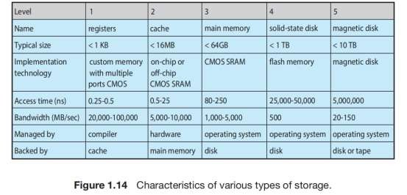
Unit I - INTRODUCTION TO OPERATING SYSTEMS AND PROCESSES
Resource Management
Cache Management

Slide 34
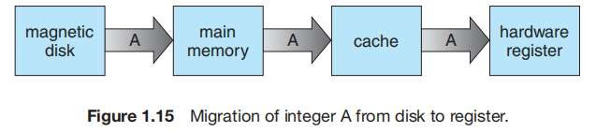
Unit I - INTRODUCTION TO OPERATING SYSTEMS AND PROCESSES
Resource Management
Cache Management
The copy of A appears in several places: on the hard disk, in main memory, in the cache, and in an internal register.
Once the increment takes place in the internal register, the value of A differs in the various storage systems.
The value of A becomes the same only after the new value of A is written from the internal register back to the hard disk.
Since the various CPUs can all execute in parallel, one must make sure that an update to the value of variable in one cache is immediately reflected in all other caches where the variable resides.
This situation is called cache coherency, and it is usually a hardware issue (handled below the operating-system level).

Slide 35
Unit I - INTRODUCTION TO OPERATING SYSTEMS AND PROCESSES
Security and Protection
Protection is any mechanism for controlling the access of processes or users to the resources defined by a computer system
This mechanism must provide means to specify the controls to be imposed and to enforce the controls.
Protection can improve reliability by detecting latent errors at the interfaces between component subsystems
A protection-oriented system provides a means to distinguish between authorized and unauthorized usage.
A system can have adequate protection but still be prone to failure and allow inappropriate access.
The job of security to defend a system from external and internal attacks.
Such attacks spread across a huge range and include viruses and worms, denial-of service attacks (which use all of a system’s resources and so keep legitimate users out of the system), identity theft, and theft of service (unauthorized use of a system).

Slide 36
Unit I - INTRODUCTION TO OPERATING SYSTEMS AND PROCESSES
Security and Protection
Prevention of some of the attacks is considered an operating system function on some systems, while other systems leave it to policy or additional software.
Due to the alarming rise in security incidents, operating system security features are a fast-growing area of research and implementation
Protection and security require the system to be able to distinguish among all its users.
Most operating systems maintain a list of user names and associated user identifier (user IDs).
In Windows parlance, this is a security ID (SID).
These numerical IDs are unique, one per user.

Slide 37
Unit I - INTRODUCTION TO OPERATING SYSTEMS AND PROCESSES
Virtualization
Virtualization is a technology that allows us to abstract the hardware of a single computer (the CPU, memory, disk drives, network interface cards, and so forth) into several different execution environments, thereby creating the illusion that each separate environment is running on its own private computer.
Environments can be viewed as different individual operating systems (for example, Windows and UNIX) that may be running at the same time and may interact with each other.
A user of a virtual machine can switch among the various operating systems in the same way a user can switch among the various processes running concurrently in a single operating system

Slide 38
Unit I - INTRODUCTION TO OPERATING SYSTEMS AND PROCESSES
Virtualization
Emulation, which involves simulating computer hardware in software, is typically used when the source CPU type is different from the target CPU type.
For example, when Apple switched from the IBM Power CPU to the Intel x86 CPU for its desktop and laptop computers
it included an emulation facility called “Rosetta,” which allowed applications compiled for the IBM CPU to run on the Intel CPU

Slide 39
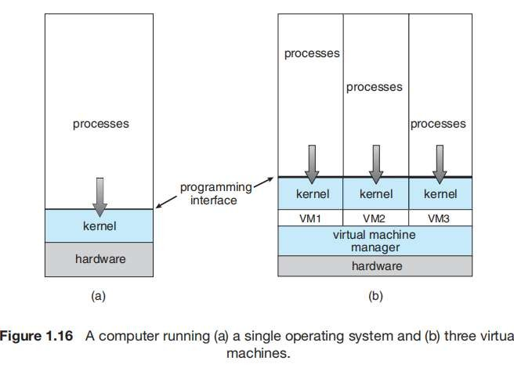
Unit I - INTRODUCTION TO OPERATING SYSTEMS AND PROCESSES
Virtualization
Running multiple virtual machines allowed (and still allows) many users to run tasks on a system designed for a singe user.
Later, in response to problems with running multiple Microsoft Windows applications on the Intel x86 CPU, VMware created a new virtualization technology in the form of an application that ran on Windows.
That application ran one or more guest copies of Windows or other native x86 operating systems, each running its own applications

Slide 40
Unit I - INTRODUCTION TO OPERATING SYSTEMS AND PROCESSES
Virtualization
Windows was the host operating system.
The VMware application was the virtual machine manager (VMM).
The VMM runs the guest operating systems, manages their resource use, and protects each guest from the others.
On laptops and desktops, a VMM allows the user to install multiple operating systems for exploration or to run applications written for operating systems other than the native host.
Companies writing software for multiple operating systems can use virtualization to run all of those operating systems on a single physical server for development, testing, and debugging

Slide 41
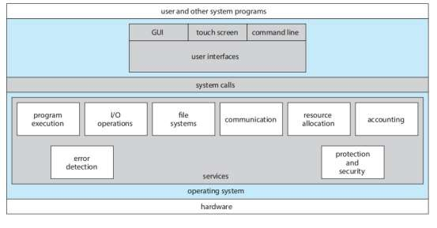
Unit I - INTRODUCTION TO OPERATING SYSTEMS AND PROCESSES
Operating System Services

Slide 42
Unit I - INTRODUCTION TO OPERATING SYSTEMS AND PROCESSES
Operating System Services
An operating system provides an environment for the execution of programs.
It makes certain services available to programs and to the users of those programs.
The specific services provided, of course, differ from one operating system to another, common classes of services given in one view of the various operating-system services and how they interrelate.
1. User interface.
Almost all operating systems have a user interface (UI). This interface can take several forms.
Most commonly, a graphical user interface (GUI) is used the interface is a window system with a mouse that serves as a pointing device to direct I/O, choose from menus, and make selections and a keyboard to enter text.
Mobile systems such as phones and tablets provide a touch-screen interface, enabling users to slide their fingers across the screen or press buttons on the screen to select choices.
Another option is a command-line interface (CLI), which uses text commands and a method for entering them (say, a keyboard for typing in commands in a specific format with specific options).

Slide 43
Unit I - INTRODUCTION TO OPERATING SYSTEMS AND PROCESSES
Operating System Services
2. Program execution.
The system must be able to load a program into memory and to run that program. The program must be able to end its execution, either normally or abnormally (indicating error).
3. I/O operations.
A running program may require I/O, which may involve a file or an I/O device. For specific devices, special functions may be desired (such as reading from a network interface or writing to a file system).
For efficiency and protection, users usually cannot control I/O devices directly. Therefore, the operating system must provide a means to do I/O.
4. File-system manipulation
Programs need to read and write files and directories.
They also need to create and delete them by name, search for a given file, and list file information. Finally, some operating systems include permissions management to allow or deny access to files or directories based on file ownership.
Many operating systems provide a variety of file systems, sometimes to allow personal choice and sometimes to provide specific features or performance characteristics.
5. Communications.
There are many circumstances in which one process needs to exchange information with another process.
Communications may be implemented via shared memory, in which two or more processes read and write to a shared section of memory, or message passing, in which packets of information in predefined formats are moved between processes by the operating system.

Slide 44
Unit I - INTRODUCTION TO OPERATING SYSTEMS AND PROCESSES
Operating System Services
6. Error detection.
The operating system needs to be detecting and correcting errors constantly.
Errors may occur in the CPU and memory hardware (such as a memory error or a power failure), in I/O devices (such as a parity error on disk, a connection failure on a network, or lack of paper in the printer), and in the user program (such as an arithmetic overflow or an attempt to access an illegal memory location).
For each type of error, the operating system should take the appropriate
action to ensure correct and consistent computing.
7. Resource allocation.
When there are multiple processes running at the same time, resources
must be allocated to each of them.
The operating system manages many different types of resources. Some (such as CPU cycles, main memory, and file storage) may have special allocation code, whereas others (such as I/O devices) may have much more general request and release code.
There may also be routines to allocate printers, USB storage drives, and other peripheral devices.
8. Logging.
We want to keep track of which programs use how much and what kinds of computer resources.
This record keeping may be used for accounting (so that users can be billed) or simply for accumulating usage statistics.
Usage statistics may be a valuable tool for system administrators who wish to reconfigure the system to improve computing services.

Slide 45
Unit I - INTRODUCTION TO OPERATING SYSTEMS AND PROCESSES
Operating System Services
9. Protection and security.
The owners of information stored in a multiuser or networked computer
system may want to control use of that information.
When several separate processes execute concurrently, it should not be possible for one process to interfere with the others or with the operating system itself.
Protection involves ensuring that all access to system resources is controlled.
Security of the system from outsiders is also important. Such security starts with requiring each user to authenticate himself or herself to the system, usually by means of a password, to gain access to system resources.
It extends to defending external I/O devices, including network adapters, from invalid access attempts and recording all such connections for detection of break-ins. If a system is to be protected and secure, precautions must be instituted throughout it. A chain is only as strong as its weakest link.

Slide 46
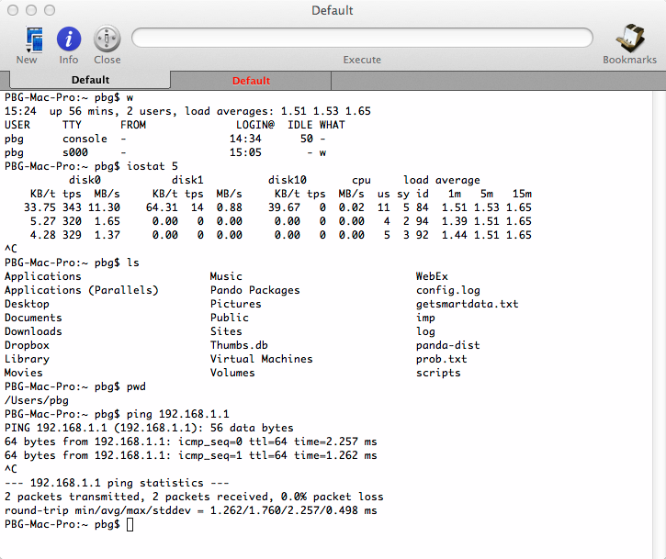
Unit I - INTRODUCTION TO OPERATING SYSTEMS AND PROCESSES
User and Operating-System Interface
CLI or command interpreter allows direct command entry
Sometimes implemented in kernel, sometimes by systems program
Sometimes multiple flavors implemented – shells
Primarily fetches a command from user and executes it
Sometimes commands built-in, sometimes just names of programs
If the latter, adding new features doesn’t require shell modification

Slide 47
Unit I - INTRODUCTION TO OPERATING SYSTEMS AND PROCESSES
User and Operating-System Interface
Graphical User Interface
User-friendly desktop metaphor interface
Usually mouse, keyboard, and monitor
Icons represent files, programs, actions, etc
Various mouse buttons over objects in the interface cause various actions (provide information, options, execute function, open directory (known as a folder)
Invented at Xerox PARC
Many systems now include both CLI and GUI interfaces
Microsoft Windows is GUI with CLI “command” shell
Apple Mac OS X is “Aqua” GUI interface with UNIX kernel underneath and shells available
Unix and Linux have CLI with optional GUI interfaces (CDE, KDE, GNOME)

Slide 48

Unit I - INTRODUCTION TO OPERATING SYSTEMS AND PROCESSES
User and Operating-System Interface
Touchscreen devices require new interfaces
Mouse not possible or not desired
Actions and selection based on gestures
Virtual keyboard for text entry
Voice commands.

Slide 49
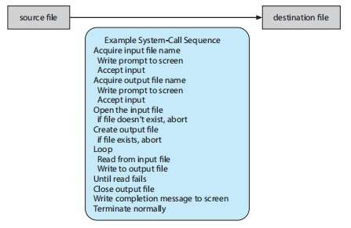
Unit I - INTRODUCTION TO OPERATING SYSTEMS AND PROCESSES
System Calls
System calls provide an interface to the services made available by an operating system.
These calls are generally available as functions written in C and C++
Certain low-level tasks may have to be written using assembly- language instructions.
One approach is to pass the names of the two
Files as part of the command— for example, the UNIX cp command:
cp in.txt out.txt
A second approach is for the program to ask the user for the names

Slide 50
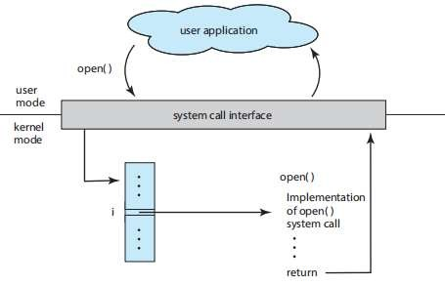
Unit I - INTRODUCTION TO OPERATING SYSTEMS AND PROCESSES
System Calls
Application Programming Interface
API specifies a set of functions that are available to an application programmer, including the parameters that are passed to each function and the return values the programmer can expect.
Another important factor in handling system calls is the run-time environment (RTE)— the full suite of software needed to execute applications written in a given programming language, including its compilers or interpreters as well as other software, such as libraries and loaders
The handling of a user application invoking the open() system call

Slide 51
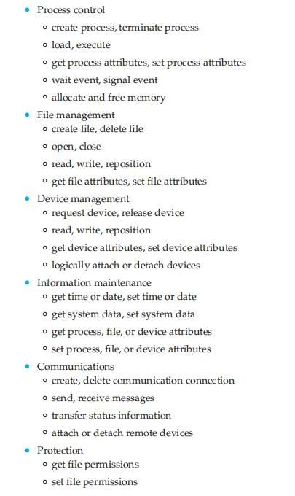
Unit I - INTRODUCTION TO OPERATING SYSTEMS AND PROCESSES
System Calls
Types of System Calls
System calls can be grouped roughly into six major categories:
Process control
File management
Device management,
Information maintenance
Communications
Protection.

Slide 52
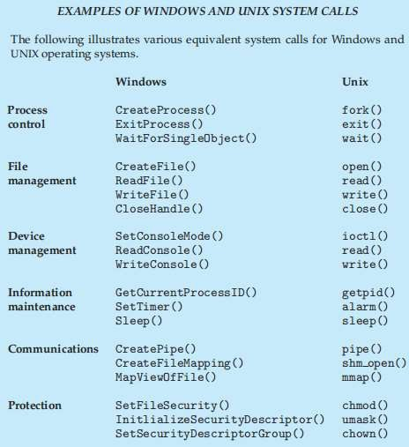
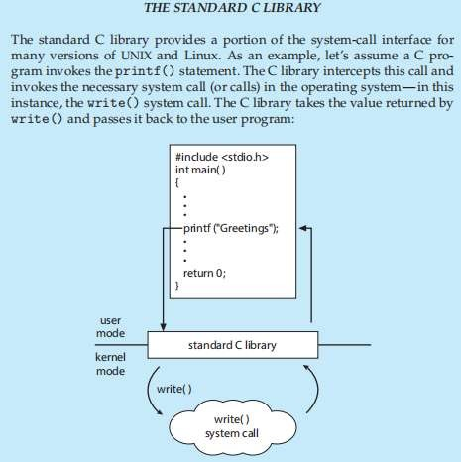
Unit I - INTRODUCTION TO OPERATING SYSTEMS AND PROCESSES
System Calls

Slide 53
Unit I - INTRODUCTION TO OPERATING SYSTEMS AND PROCESSES
System Services
System services, also known as system utilities, provide a convenient environment for program development and execution.
Some of them are simply user interfaces to system calls. Others are considerably more complex.
They can be divided into these categories:
File management
Status information
Programming-language support
Program loading and execution
Communications
Background services

Slide 54
Unit I - INTRODUCTION TO OPERATING SYSTEMS AND PROCESSES
Operating System Design and Implementation
Design and Implementation of OS not “solvable”, but some approaches have proven successful
Internal structure of different Operating Systems can vary widely
Start the design by defining goals and specifications
Affected by choice of hardware, type of system
User goals and System goals
User goals – operating system should be convenient to use, easy to learn, reliable, safe, and fast
System goals – operating system should be easy to design, implement, and maintain, as well as flexible, reliable, error-free, and efficient
Important principle to separate
Policy: What will be done? Mechanism: How to do it?
Mechanisms determine how to do something, policies decide what will be done
The separation of policy from mechanism is a very important principle, it allows maximum flexibility if policy decisions are to be changed later (example – timer)
Specifying and designing an OS is highly creative task of software engineering

Slide 55
Unit I - INTRODUCTION TO OPERATING SYSTEMS AND PROCESSES
Operating System Design and Implementation
In the worst case,
Each change in policy would require a change in the underlying mechanism.
A general mechanism flexible enough to work across a range of policies is preferable.
A change in policy would then require redefinition of only certain parameters of the system
EX: Consider a mechanism for giving priority to certain types of programs over others.
If the mechanism is properly separated from policy,
it can be used either to support a policy decision that I/O-intensive programs should have priority over CPU-intensive ones or
to support the opposite policy
Microkernel-based operating systems :
take the separation of mechanism and policy to one extreme by implementing a basic set of primitive building blocks.
These blocks are almost policy free,
Windows:
Microsoft has closely encoded both mechanism and policy into the system
All applications have similar interfaces, because the interface itself is built into the kernel and system libraries.

Slide 56
Unit I - INTRODUCTION TO OPERATING SYSTEMS AND PROCESSES
Building and Booting an Operating System
Operating-System Generation
Generating (or building) an operating system from scratch,
steps:
1. Write the operating system source code (or obtain previously written source code).
2. Configure the operating system for the system on which it will run.
3. Compile the operating system.
4. Install the operating system.
5. Boot the computer and its new operating system.
Operating systems are designed to run on any of a class of machines; the system must be configured for each specific computer site
SYSGEN program obtains information concerning the specific configuration of the hardware system
Used to build system-specific compiled kernel or system-tuned
Can general more efficient code than one general kernel

Slide 57
Unit I - INTRODUCTION TO OPERATING SYSTEMS AND PROCESSES
Building and Booting an Operating System
System Boot
When power initialized on system, execution starts at a fixed memory location
Firmware ROM used to hold initial boot code
Operating system must be made available to hardware so hardware can start it
Small piece of code – bootstrap loader, stored in ROM or EEPROM locates the kernel, loads it into memory, and starts it
Sometimes two-step process where boot block at fixed location loaded by ROM code, which loads bootstrap loader from disk
Common bootstrap loader, GRUB, allows selection of kernel from multiple disks, versions, kernel options
Kernel loads and system is then running

Slide 58
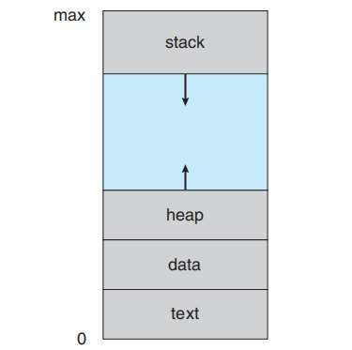
Unit I - INTRODUCTION TO OPERATING SYSTEMS AND PROCESSES
Process Concept
Process – A process can be thought of as a program in execution.
The status of the current activity of a process is represented by the value of the program counter and the contents of the processor’s registers.
The memory layout of a process is typically divided into multiple sections
Text section— the executable code
Data section—global variables
Heap section—memory that is dynamically allocated during program
runtime
Stack section— temporary data storage when invoking functions (such as function parameters, return addresses, and local variables)
Layout of a process in memory

Slide 59
Unit I - INTRODUCTION TO OPERATING SYSTEMS AND PROCESSES
Process Concept
The sizes of the text and data sections are fixed, as their sizes do not change during program run time.
However, the stack and heap sections can shrink and grow dynamically during program execution.
Each time a function is called, an activation record containing function
parameters, local variables, and the return address is pushed onto the stack;
when control is returned from the function, the activation record is popped from the stack.
Similarly, the heap will grow as memory is dynamically allocated, and will shrink when memory is returned to the system.
Although the stack and heap sections grow toward one another, the operating system must ensure they do not overlap one another.

Slide 60
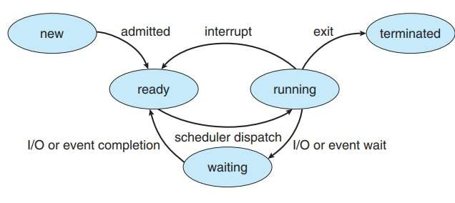
Unit I - INTRODUCTION TO OPERATING SYSTEMS AND PROCESSES
Process Concept
As a process executes, it changes state. A process may be in one of the following states:
New - The process is being created.
Running - Instructions are being executed.
Waiting - The process is waiting for some event to occur (such as an I/O completion or reception of a signal).
Ready - The process is waiting to be assigned to a processor.
Terminated - The process has finished execution.
Diagram of Process state

Slide 61
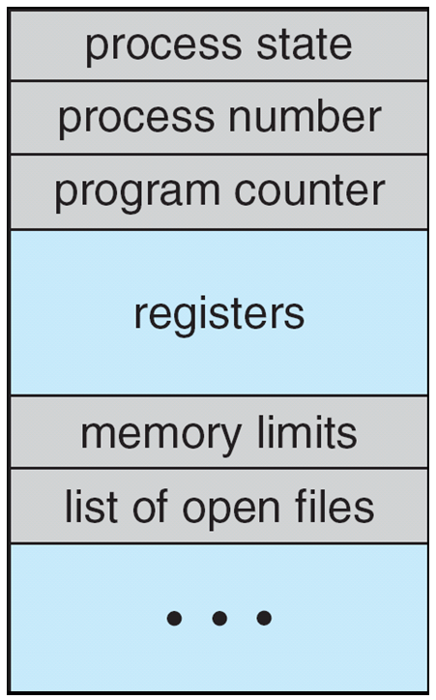
Unit I - INTRODUCTION TO OPERATING SYSTEMS AND PROCESSES
Process Concept
Process Control Block
Information associated with each process
(also called task control block)
Process state – running, waiting, etc
Program counter – location of instruction to next execute
CPU registers – contents of all process-centric registers
CPU scheduling information- priorities, scheduling queue pointers
Memory-management information – memory allocated to the process
Accounting information – CPU used, clock time elapsed since start, time limits
I/O status information – I/O devices allocated to process, list of open files

Slide 62
Unit I - INTRODUCTION TO OPERATING SYSTEMS AND PROCESSES
Process Scheduling
The objective of multiprogramming is to have some process running at all times, to maximize CPU utilization.
The objective of time sharing is to switch the CPU among processes so frequently that users can interact with each program.
To meet these objectives, the process scheduler selects an available process (possibly from a set of several available processes) for program execution on a core.
Each CPU core can run one process at a time.
For a system with a single CPU core, there will never be more than one process running at a time,
whereas a multicore system can run multiple processes at one time.
If there are more processes than cores, excess processes will have to wait until a core is free and can be rescheduled.
The number of processes currently in memory is known as the degree of multiprogramming.
Most processes can be described as either I/O bound or CPU bound.
An I/O-bound process is one that spends more of its time doing I/O than it spends doing computations.
A CPU-bound process, in contrast, generates I/O requests infrequently, using more of its time doing computations.

Slide 63
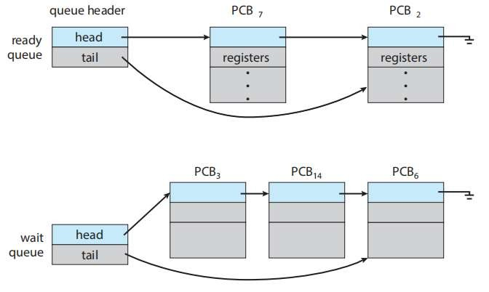
Unit I - INTRODUCTION TO OPERATING SYSTEMS AND PROCESSES
Process Scheduling
As processes enter the system, they are put into a ready queue, where they are ready and waiting to execute on a CPU’s core.
This queue is generally stored as a linked list; a ready-queue header contains pointers to the first PCB in the list, and each PCB includes a pointer field that points to the next PCB in the ready queue.

Slide 64
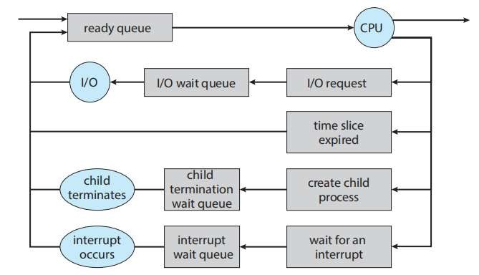
Unit I - INTRODUCTION TO OPERATING SYSTEMS AND PROCESSES
Process Scheduling
A common representation of process scheduling is a queueing diagram.
Two types of queues are present: the ready queue and a set of wait queues.
The circles represent the resources that serve the queues, and the arrows indicate the flow of processes in the system.
A new process is initially put in the ready queue. It waits there until it is selected for execution, or dispatched.
Once the process is allocated a CPU core and is executing, one of several events could occur:
The process could issue an I/O request and then be placed in an I/O wait queue.
The process could create a new child process and then be placed in a wait queue while it awaits the child’s termination.
The process could be removed forcibly from the core, as a result of an interrupt or having its time slice expire, and be put back in the ready queue.
In the first two cases, the process eventually switches from the waiting state to the ready state and is then put back in the ready queue.
A process continues this cycle until it terminates, at which time it is removed from all queues and has its PCB and resources deallocated.
Queueing-diagram representation
of process scheduling

Slide 65
Unit I - INTRODUCTION TO OPERATING SYSTEMS AND PROCESSES
Process Scheduling
CPU Scheduling
A process migrates among the ready queue and various wait queues throughout its lifetime
The role of the CPU scheduler is to select from among the processes that are in the ready queue and allocate a CPU core to one of them
The CPU scheduler must select a new process for the CPU frequently
An I/O-bound process may execute for only a few milliseconds before waiting for an I/O request.
Although a CPU-bound process will require a CPU core for longer durations, the scheduler is unlikely to grant the core to a process for an extended period
Instead, it is likely designed to forcibly remove the CPU from a process and schedule another process to run
Therefore, the CPU scheduler executes at least once every 100 milliseconds, although typically much more frequently

Slide 66
Unit I - INTRODUCTION TO OPERATING SYSTEMS AND PROCESSES
Process Scheduling
Swapping:
Some operating systems have an intermediate form of scheduling, known as swapping
key idea is that to remove a process from memory (and from active contention for the CPU) and reduce the degree of multiprogramming.
Later, the process can be reintroduced into memory, and its execution can be continued where it left off.
a process can be “swapped out” from memory to disk, where its current status is saved, and
later “swapped in” from disk back to memory, where its status is restored.
Swapping is typically only necessary when memory has been overcommitted and must be freed up.

Slide 67
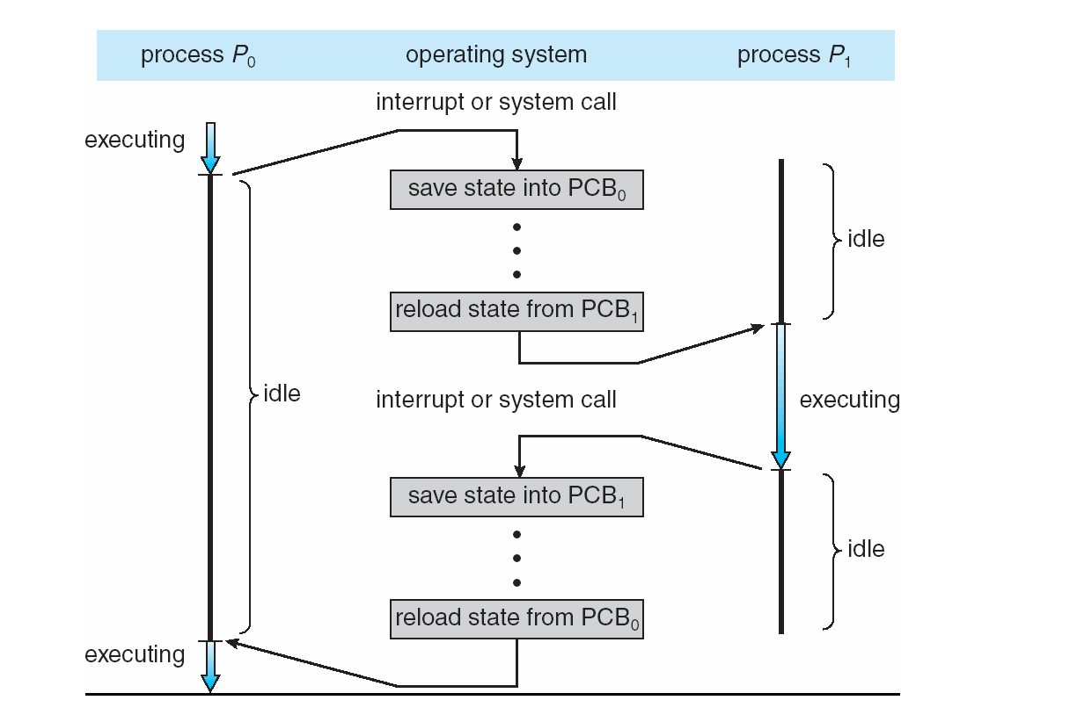
Unit I - INTRODUCTION TO OPERATING SYSTEMS AND PROCESSES
Process Scheduling
When an interrupt occurs
The system needs to save the current context of the process running on the CPU core.
It can restore that context when its processing is done.
Essentially suspending the process and then resuming it.
The context is represented in the PCB of the process. It includes
the value of the CPU registers
the process state and
memory-management information.
Switching the CPU core to another process requires performing a state save of the current process and a state restore of a different process. This task is known as a context switch

Slide 68
Unit I - INTRODUCTION TO OPERATING SYSTEMS AND PROCESSES
Operations on Process
System must provide mechanisms for:
process creation
process termination
Process Creation
A process may create several new processes. The creating process is called a parent process, and the new processes are called the children of that process.
Each of these new processes may in turn create other processes, forming a tree of processes.
Most operating systems (including UNIX, Linux, and Windows) identify processes according to a unique process identifier (or pid), which is typically an integer number.
The pid provides a unique value for each process in the system, and it can be used as an index to access various attributes of a process within the kernel.

Slide 69
Unit I - INTRODUCTION TO OPERATING SYSTEMS AND PROCESSES
Operations on Process
In general, when a process creates a child process, that child process will need certain resources (CPU time, memory, files, I/O devices) to accomplish its task.
A child process may be able to obtain
its resources directly from the operating system, or
it may be constrained to a subset of the resources of the parent process.
The parent may have
to partition its resources among its children, or
it may be able to share some resources (such as memory or files) among several of its children

Slide 70
Unit I - INTRODUCTION TO OPERATING SYSTEMS AND PROCESSES
Operations on Process
Process Termination
A process terminates when it finishes executing its final statement and asks the operating system to delete it by using the exit() system call.
At that point, the process may return a status value (typically an integer) to its parent process (via the wait() system call)
All the resources of the process—including physical and virtual memory, open files, and I/O buffers are deallocated by the operating system.
A parent may terminate the execution of one of its children for a variety of reasons, such as these:
The child has exceeded its usage of some of the resources that it has been allocated.
The task assigned to the child is no longer required.
The parent is exiting, and the operating system does not allow a child to continue if its parent terminates.
Some systems do not allow a child to exist if its parent has terminated. In such systems, if a process terminates (either normally or abnormally), then all its children must also be terminated. This phenomenon, referred to as cascading termination, is normally initiated by the operating system.

Slide 71
Unit I - INTRODUCTION TO OPERATING SYSTEMS AND PROCESSES
Operations on Process
Process Termination
To illustrate process execution and termination, consider that, in Linux and UNIX systems, we can terminate a process by using the exit() system call, providing an exit status as a parameter:
exit(1);
When a process terminates,
its resources are deallocated by the operating system.
However, its entry in the process table must remain there until the parent calls wait()
A process that has terminated, but whose parent has not yet called wait(), is known as a zombie process.
If a parent did not invoke wait() and instead terminated, thereby leaving its child processes as orphans.
Traditional UNIX systems addressed this scenario by assigning the init process as the new parent to orphan processes.
The init process periodically invokes wait(), thereby allowing the exit status of any orphaned process to be collected and releasing the orphan’s process identifier and process-table entry.

Slide 72
Unit I - INTRODUCTION TO OPERATING SYSTEMS AND PROCESSES
Operations on Process
Process Termination - Android Process Hierarchy
It terminates processes in order of increasing importance. From most to least important, the hierarchy of process classifications is as follows:
Foreground process—The current process visible on the screen, represent_x0002_ing the application the user is currently interacting with
Visible process—A process that is not directly visible on the foreground but that is performing an activity that the foreground process is referring to (that is, a process performing an activity whose status is displayed on the foreground process)
Service process—A process that is similar to a background process but is performing an activity that is apparent to the user (such as streaming music)
Background process—A process that may be performing an activity but is not apparent to the user.
Empty process—A process that holds no active components associated with any application
If system resources must be reclaimed, Android will first terminate empty processes, followed by background processes, and so forth.

Slide 73
Unit I - INTRODUCTION TO OPERATING SYSTEMS AND PROCESSES
Interprocess Communication
Processes executing concurrently in the operating system may be either independent processes or cooperating processes.
A process is independent if it cannot affect or be affected by the other processes executing in the system. Any process that does not share data with any other process is independent.
A process is cooperating if it can affect or be affected by the other processes executing in the system. Clearly, any process that shares data with other processes is a cooperating process.
Several reasons for process cooperation:
Information sharing. Since several users may be interested in the same piece of information (for instance, a shared file), we must provide an environment to allow concurrent access to such information.
Computation speedup. If we want a particular task to run faster, we must break it into subtasks, each of which will be executing in parallel with the others.
Modularity. We may want to construct the system in a modular fashion, dividing the system functions into separate processes or threads
Convenience. Even an individual user may work on many tasks at the same time.
Ex: For instance, a user may be editing, listening to music, and compiling in parallel.

Slide 74
Unit I - INTRODUCTION TO OPERATING SYSTEMS AND PROCESSES
Interprocess Communication
Cooperating processes require an interprocess communication (IPC) mechanism that will allow them to exchange data and information. There are two fundamental models of interprocess communication:
In the shared- memory model, a region of memory that is shared by cooperating processes is established. Processes can then exchange information by reading and writing data to the shared region.
In the message-passing model, communication takes place by means of messages exchanged between the cooperating processes.

Slide 75
Unit I - INTRODUCTION TO OPERATING SYSTEMS AND PROCESSES
Interprocess Communication
Shared- memory mode
One solution to the producer–consumer problem uses shared memory.
To allow producer and consumer processes to run concurrently
a buffer of items that can be filled by the producer and emptied by the consumer.
This buffer will reside in a region of memory that is shared by the producer and consumer processes.
A producer can produce one item while the consumer is consuming another item.
The producer and consumer must be synchronized, so that the consumer does not try to consume an item that has not yet been produced.

Slide 76
Unit I - INTRODUCTION TO OPERATING SYSTEMS AND PROCESSES
Interprocess Communication
Shared- memory mode
Two types of buffers can be used.
The unbounded buffer places no practical limit on the size of the buffer.
The consumer may have to wait for new items
The producer can always produce new items.
The bounded buffer assumes a fixed buffer size.
The consumer must wait if the buffer is empty
The producer must wait if the buffer is full.
The following variables reside in a region of memory shared by the producer and consumer processes.
#define BUFFER SIZE 10
typedef struct {
. . .
}item;
item buffer[BUFFER SIZE]; int in = 0; int out = 0;

Slide 77
Unit I - INTRODUCTION TO OPERATING SYSTEMS AND PROCESSES
Interprocess Communication
Shared- memory mode
The shared buffer is implemented as a circular array with two logical pointers: in and out.
The variable in points to the next free position in the buffer;
out points to the first full position in the buffer.
The buffer is empty when in == out;
the buffer is full when ((in + 1) % BUFFER SIZE) == out
Producer Process:
item next produced; while (true) {
/* produce an item in next produced */ while (((in + 1) % BUFFER SIZE) == out)
; /* do nothing */
buffer[in] = next produced;
in = (in + 1) % BUFFER SIZE;

Slide 78
Unit I - INTRODUCTION TO OPERATING SYSTEMS AND PROCESSES
Interprocess Communication
Shared- memory mode
Consumer Process
item next consumed; while (true) {
while (in == out)
; /* do nothing */
next consumed = buffer[out]; out = (out + 1) % BUFFER SIZE;
/* consume the item in next consumed */
The producer process has a local variable next produced in which the new item to be produced is stored.
The consumer process has a local variable next consumed in which the item to be consumed is stored.

Slide 79
Unit I - INTRODUCTION TO OPERATING SYSTEMS AND PROCESSES
Interprocess Communication
IPC in Message-Passing Systems
Cooperating processes communicate with each other via a message-passing facility.
Message passing provides a mechanism to allow processes to communicate and to synchronize their actions without sharing the same address space
A message- passing facility provides at least two operations:
send(message) receive(message)
If processes P and Q want to communicate
send messages to and receive messages from each other
a communication link must exist between them
here not with the link’s physical implementation but rather with its logical implementation
Methods for logically implementing a link and the send()/receive() operations:
Direct or indirect communication
Synchronous or asynchronous communication
Automatic or explicit buffering

Slide 80
Unit I - INTRODUCTION TO OPERATING SYSTEMS AND PROCESSES
Interprocess Communication
IPC in Message-Passing Systems
Direct Communication:
Naming
Processes that want to communicate must have a way to refer to each other.
Can use either direct or indirect communication.
Under direct communication, each process that wants to communicate must explicitly name the recipient or sender of the communication.
In this scheme, the send() and receive() primitives are defined as:
send(P, message)—Send a message to process P.
receive(Q, message)—Receive a message from process Q.

Slide 81
Unit I - INTRODUCTION TO OPERATING SYSTEMS AND PROCESSES
Interprocess Communication
IPC in Message-Passing Systems
Naming
Symmetry in addressing:
A link is established automatically between every pair of processes that want to
communicate.
The processes need to know only each other’s identity to communicate.
A link is associated with exactly two processes.
Between each pair of processes, there exists exactly one link.
both the sender process and the receiver process must name the other to communicate.
Asymmetry in addressing.
only the sender names the recipient
the recipient is not required to name the sender.
In this scheme, the send() and receive() primitives are defined as follows:
send(P, message)—Send a message to process P.
receive(id, message)—Receive a message from any process.
The variable id is set to the name of the process with which communication has taken place.

Slide 82
Unit I - INTRODUCTION TO OPERATING SYSTEMS AND PROCESSES
Interprocess Communication
IPC in Message-Passing Systems
Indirect Communication:
The messages are sent to and received from mailboxes, or ports.
A mailbox can be viewed abstractly as an object into which messages can be placed by processes and from which messages can be removed.
Each mailbox has a unique identification.
A process can communicate with another process via a number of different mailboxes, but two processes can communicate only if they have a shared mailbox.
The send() and receive() primitives are defined as follows:
send(A, message)—Send a message to mailbox A.
receive(A, message)—Receive a message from mailbox A.
In this scheme, a communication link has the following properties:
A link is established between a pair of processes only if both members of the pair have a shared mailbox.
A link may be associated with more than two processes.
Between each pair of communicating processes, a number of different links may exist, with each link corresponding to one mailbox.

Slide 83
Unit I - INTRODUCTION TO OPERATING SYSTEMS AND PROCESSES
Interprocess Communication
IPC in Message-Passing Systems
Indirect Communication:
Suppose that processes P1, P2, and P3 all share mailbox A. Process P1 sends a message to A, while both P2 and P3 execute a receive() from A. Which process will receive the message sent by P1? The answer depends on which of the following methods we choose:
Allow a link to be associated with two processes at most.
Allow at most one process at a time to execute a receive() operation.
Allow the system to select arbitrarily which process will receive the message (that is, either P2 or P3, but not both, will receive the message). The system may define an algorithm for selecting which process will receive the message

Slide 84
Unit I - INTRODUCTION TO OPERATING SYSTEMS AND PROCESSES
Interprocess Communication
Synchronization
Communication between processes takes place through calls to send() and receive() primitives.
There are different design options for implementing each primitive.
Message passing may be either blocking or nonblocking— also known as synchronous and asynchronous.
Blocking send. The sending process is blocked until the message is received by the receiving process or by the mailbox.
Nonblocking send. The sending process sends the message and resumes operation.
Blocking receive. The receiver blocks until a message is available.
Nonblocking receive. The receiver retrieves either a valid message or a null.

Slide 85
Unit I - INTRODUCTION TO OPERATING SYSTEMS AND PROCESSES
Interprocess Communication
Synchronization
Buffering
Whether communication is direct or indirect, messages exchanged by communicating processes reside in a temporary queue. Basically, such queues can be implemented in three ways:
Zero capacity.
The queue has a maximum length of zero
thus, the link cannot have any messages waiting in it.
In this case, the sender must block until the recipient receives the message.
Bounded capacity.
The queue has finite length n; thus, at most n messages can reside in it
If the queue is not full when a new message is sent, the message is placed in the queue, and the sender can continue execution without waiting.
The link’s capacity is finite, however. If the link is full, the sender must block until space is available in the queue.

Slide 86
Unit I - INTRODUCTION TO OPERATING SYSTEMS AND PROCESSES
Interprocess Communication
The zero-capacity case is sometimes referred to as a message system with no buffering. The other cases are referred to as systems with automatic buffering.

